Slide 1
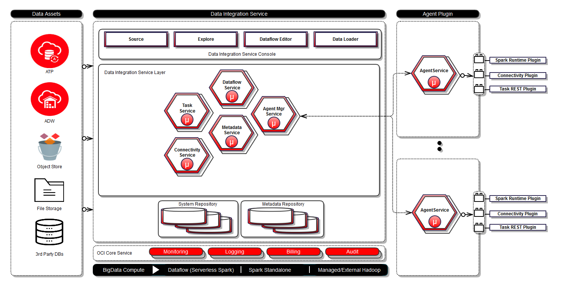
Data Integration Service (DIS)
Key focus on regression and coverage enhancements
Summary :
Pre GA: Early Engineering, Performance POC’s, Sizing and Scaling guidelines
Post GA: Benchmarking ,Release coverage, Coverage enhancements and CICD Automation .
Pre GA coverage :
Unstable environment , huge UI timings and failures in the Data flow execution
Multiple PSR optimizations including pagination, retrieving larger data set and POC’s
Rest API Invocation : 46% not meeting KPI in LA and 70% in GA .
Optimizations :
JVM tunings – Suggested optimal JVM parameters
Rest API performance – Recommended pagination and batching of data
Spark – Identified memory leaks and suggested fixes, recommended BV over FSS ,suggested improvements for driver re-initialization .
Metadata : Suggested improvements for CPU utilization (rngd).
Diagnostics : Recommend all metrics to be pushed to T2 and suggested profiling parameters.
Key POCs | Problem Statement | Status/Progress
Metadata DB consolidation | Creation of ATP per tenant amounted to resource and cost implications Initial implementation by Dev was using connection pool per tenant (non-scalable) | Performance POC DB – Avoid creating ATP per tenant instead use Shared ATP for Metadata Service (significant cost saving) Provided implementation for using Proxy schema & connection labeling Achieved up to 10x reduction in RT – optimizations include query optimizations, index fixes, lazy loading.
Spark sizing and scaling | Non scalable spark cluster OOTB VM configuration due to over-subscription of memory causing JVM crash BV vs FSS comparison | Sizing - Published comprehensive sizing guidelines based on CPU/Memory to handle interactive and batch job requests IO - Recommended Block volume over FSS as Shuffle location (4x RT impact with FSS) Memory - Optimization proposed for reducing memory foot print of Livy driver (REST interface for Spark Cluster)

Slide 2
Data Integration Service (DIS) –Key issues/Optimizations –Pre GA/GA
Category | Bug | Key issue | Optimizations Proposed/Impact | Impact |  | Status
JVM Tunings | DRS-365,DIS-7079,DIS-7076 and DIS-7075 | JVM options are not optimal for all DIS Services | Suggested proper tunings to have better performance |  |  | Resolved
Rest API | DIS-5754 | List Data entities click ~41s for single user | Implemented pagination . |  | reduced to 3 s from 41 s. | Resolved
 | DIS-5660 | Data grid fails to load larger size > 10 M | Take required rows (to be sent to UI) and then convert it to JSON string.. |  | Able to load larger data in grid | Resolved
Spark | DIS-7604,DIS-7452 | OOM error observed for Spark driver. | Restrict partition Cache size to 100MB and Livy retained statement execution to 20 from 300 |  | No memory leak in endurance test . | Resolved
 | DIS-7441 | Driver Re-initialization does not honor the interactive limits impose | kill the session from spark plugin based on following parameters Session up for 2 hours OR 200 statements executed in session |  | Driver JVM reinitialized properly . | Resolved
 | DIS-4671 | POC showing Shuffle in FSS causes performance degradation | Recommended Block volume over FSS as Shuffle location |  | 4x improvement in timing. | Resolved
 | DIS-4672 | Broadcast timeout during the spark execution | Increase timeout for broadcasts via spark.sql.broadcastTimeout to 1200 s from 300 s |  | Data flow execution succeeded. | Resolved
Metadata | DICOM-4540 | Spike in CPU due to rngd and key generation | Disable Jitter Source in OEL7 |  | Metadata CPU reduced by 30% | Resolved
 | DICOM-2907( base bug DIS-4671) | Usage of FIRST_ROWS Hint in sql resulting in sub-optimal Explain plan | optimizer using BLOOM filter and reflects in much LOWER COST of execution. Logical IO drop by about 15X(~128K to 8K). |  | CPU utilization and RT improved | Resolved
Functional | DICOM-3394 | Database getting locked due to stale cache | Update the cache with newer password . |  | Data asset creation successful . | Resolved
Diagnostics | DIS-7083,DIS-7081 and DIS-7078 | Push GC metrics to T2 for all DIS services | Helps in debugging performance issues and save resource utilization. |  |  | Resolved
 | DICOM-3922 | Lumberjack doesn’t provide component level breakdown |  |  |  | Open
 | DICOM-5719 | Updated JFR tuning to avoid saving JFR's to disk |  |  |  | Resolved
 | DIS-4633 | Enable JFR and Heapdump Configuration during startup |  |  |  | Resolved

Slide 3
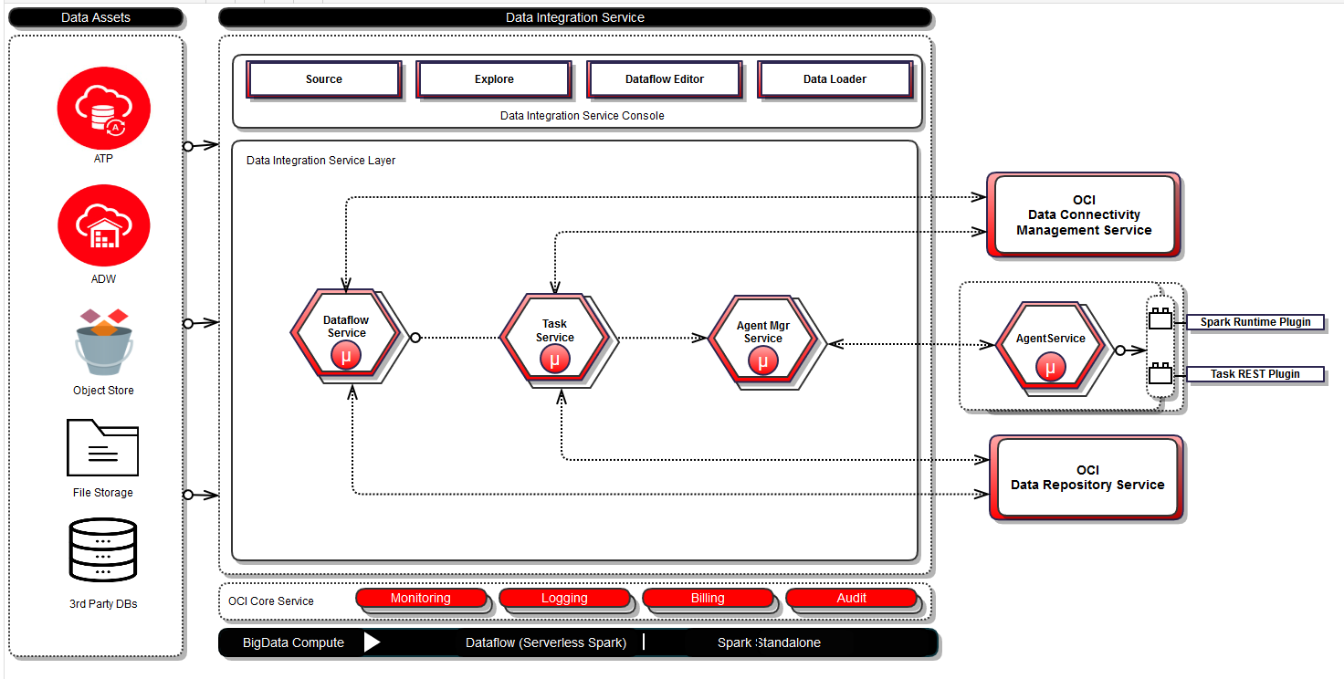
Data Integration Service (DIS)
Key focus on regression and coverage enhancements
Post GA Coverage:
Regression Coverage of Rest API and Runtime Performance
Coverage enhancements
Benchmark and optimize DIS using TPCDS complex queries.
Orchestration and Scheduling service ,DCMS(Data connectivity management service).
New features –New DF Task types Data flow service, Rest API ,Bulk data loader and LCM coverage.
Automation :Integrate key tests to CICD pipeline (Implemented using CPI)
Release Coverage Summary:
Release coverage : Completed Rest API and runtime performance on latest build .
Rest API Invocation :95% meets KPI .Max throughput ~ 28 ops/sec and Scalability load ~ 250 users.
Data Orchestration & Scheduling :
POC: Evaluate apache airflow for DOS
PSR published Best practices, Programming Pitfalls, and Sizing Guidelines
Benchmarking pipeline concurrency test in progress .
Identified tunable parameters ,tests are on going .
Data Connectivity management service : Benchmark executor service performance in progress .
Working on memory tunings for executor POD’s and scaling issues.
Continuous Performance Integration (CPI): CPI Integration to QA Pipeline for Rest API invocation is done and pre prod in progress.
Results : Regular release builds
DIS 21.c.0 Coverage | Meets KPI/Pass | Not Meeting KPI/Failed |  | NOT RUN | In Progress | Total
 | < 2 sec | > 2 s and < 6 s | > 20s and < 25 s
Rest API Invocation | 85 | 2 | 3 | 0 | 0 | 90
% | 94.5% | 2.2% | 3.3% | 0% | 0%
Data flow /Data Loader Runtime Scenarios | 25 | 0 |  | 0 |  | 25
% | 100% | 0% |  | 0% | 0%
Orchestration & Scheduling and DCMS | 0 | 0 |  | 5 | 2 | 7
% | 0% | 0% |  | 71% | 29%
Total | 110 | 5 |  | 5 | 2 | 122
% | 91% | 4% |  | 4% | 1% | 100

Slide 4
Data Integration Service (DIS) –Key issues/Optimizations-Post GA.
Category | Bug | Key issue | Optimizations Proposed/Impact | Impact | Status
Rest API | DIS-7137 | ~20s for List Dataflow response time under load | Implement lazy loading and fetch only object summary avoiding additional details . | RT reduced to 3 s from 20 s | Resolved
 | DIS-9733 DIS-9736 DIS-9584 | Slowness observed across multiple API’s involving data profiling | Removing redundant calls & avoid using physical DB connections | It saves ~ 5 sec to load Data Grid attributes and data . | Open
Runtime | DCMS-1147 | Observed performance degradation in case of DB (as Source) to DB/OSS | Data Read fetch size increased to 1000 from 10 | 30% improvement in DF when DB as source | Resolved
Production Slowness | DIS-8230 | High RT observed for Open Data flow click ~ 5.8 s. | Lazy loading of data flow nodes | RT reduced to 2.6 s from 5.8 s | Resolved
 | DCMS-1641 | MySQL connector fails processing 600M rows | Use Cursor based streaming to retrieve set of number of rows each time | MYSQL connector able to retrieve larger data | Resolved.
 | DIS-12510 | Spark Jobs failing due to space constraints. By default, the temp file is written to /tmp/Hadoop-opc (which points to local boot volume). | Configure hadoop.tmp.dir to block Storage . | Able to move larger data size from SRC to TGT. | Resolved .
Orchestration & Scheduling | DOS-2142 | DOS Webserver CPU hitting ~100% even in idle state due to gunicorn process | Gunicorn can be configured to restart after every 1000 requests. | Restarting of gunicorn process reduced to optimal value | Resolved .
 | DOS-3413 | Observed high delay in Airflow to start the DAG and stop the DAG and also inter task delay | Identified tunable parameters .Tests are in progress to find optimal values . | Overall runtime time for pipeline will be reduced . | Open.
 | DOS-3550 | Airflow marking sensor type tasks as Dependencies not met with out throwing any errors . Pipeline stuck in running state . | RCA in progress . |  | Open
Data Connectivity Management Service | DCMS-3545 | Request time out from the Splat for the executor API’s | Increase timeout value in Splat from 1 min to optimal value . | Dev is working . | Open
Diagnostics | DIS-10548 | Enable Oracle OS watcher on all DIS Production VM's | Helps in debugging performance issues and save resource utilization. |  | Open
 | DICOM-5322 | Mount Separate Block Volume for storing diagnostic logs |  |  | Open

